Slide 2
Topics
Sequences
Introduction to Lists
List Slicing
Finding Items in Lists with the in Operator
List Methods and Useful Built-in Functions

Slide 3
Topics (cont’d.)
Copying Lists
Processing Lists
Two-Dimensional Lists
Tuples
Plotting List Data with the matplotlib Package

Slide 4
Programming
Algorithm
  - A set of rules or steps used to solve a problem
Data Structure
  - A particular way of organizing data in a computer
https://en.wikipedia.org/wiki/Algorithm
https://en.wikipedia.org/wiki/Data_structure

Slide 5
What is Not a “Collection”?
Most of our variables have one value in them - when we put a new value in the variable, the old value is overwritten
$ python
>>> x = 2
>>> x = 4
>>> print(x)
4

Slide 6
Sequences
Sequence: an object that contains multiple items of data
  The items are stored in sequence one after another
Python provides different types of sequences, including lists and tuples
  The difference between these is that a list is mutable and a tuple is immutable

Slide 7
Introduction to Lists
List: an object that contains multiple data items
  Element: An item in a list
  Format: list = [item1, item2, etc.]
  Can hold items of different types
print function can be used to display an entire list
list() function can convert certain types of objects to lists

Slide 8
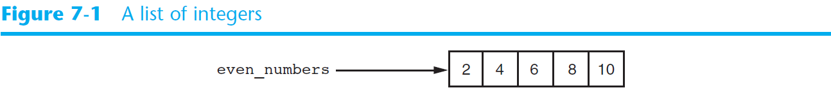
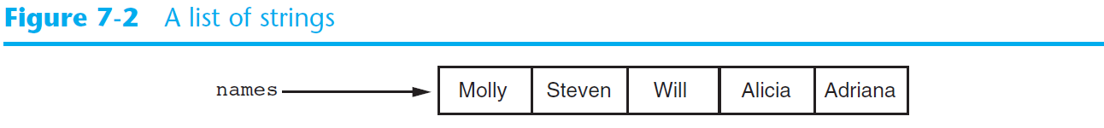
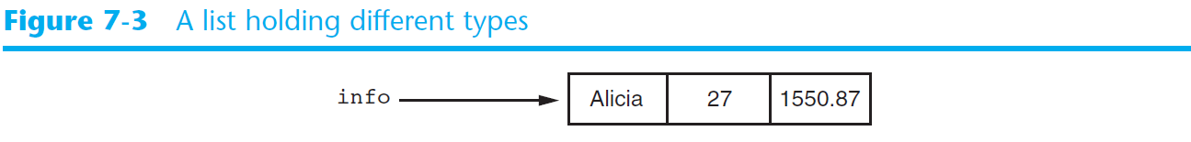
Introduction to Lists (cont’d.)

Slide 9
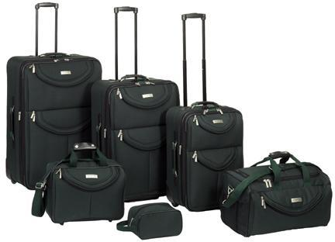
A List is a Kind of Collection
A collection allows us to put many values in a single “variable”
A collection is nice because we can carry all many values around in one convenient package.
friends = [ ‘Ali', ‘Gizem', ‘Sinem' ]
carryon = [ 'socks', 'shirt', 'perfume' ]

Slide 10
List Constants
List constants are surrounded by square brackets and the elements in the list are separated by commas
A list element can be any Python object - even another list
A list can be empty
>>> print([1, 24, 76])
[1, 24, 76]
>>> print(['red', 'yellow', 'blue'])
['red', 'yellow', 'blue']
>>> print(['red', 24, 98.6])
['red', 24, 98.6]
>>> print([ 1, [5, 6], 7])
[1, [5, 6], 7]
>>> print([])
[]

Slide 11
The Repetition Operator and Iterating over a List
Repetition operator: makes multiple copies of a list and joins them together
  The * symbol is a repetition operator when applied to a sequence and an integer
    Sequence is left operand, number is right
  General format: list * n
You can iterate over a list using a for loop
  Format: for x in list:

Slide 12
The Repetition Operator and Iterating over a List
numbers = [1, 2, 3] * 3
print (numbers)
Output_1 : [1, 2, 3, 1, 2, 3, 1, 2, 3]
numbers = [99, 100, 101, 102]
for n in numbers:
print(n)
Output_2:
99
100
101
102

Slide 13
We Already Use Lists!
for i in [5, 4, 3, 2, 1] :
print(i)
print('Blastoff!')
5
4
3
2
1
Blastoff!

Slide 14
Lists and Definite Loops - Best Pals
friends = [‘Ali', ‘Gizem', ‘Sinem']
for friend in friends :
print('Happy New Year:', friend)
print('Done!')
Happy New Year: Ali
Happy New Year: Gizem
Happy New Year: Sinem
Done!
z = [‘Ali', ‘Gizem', ‘Sinem']
for x in z:
print('Happy New Year:', x)
print('Done!')

Slide 15
Indexing
Index: a number specifying the position of an element in a list
  Enables access to individual element in list
  Index of first element in the list is 0, second element is 1, and n’th element is n-1
  Negative indexes identify positions relative to the end of the list
    The index -1 identifies the last element, -2 identifies the next to last element, etc.

Slide 16
Indexing
my_list = [10, 20, 30, 40]
print (my_list[0], my_list[1], my_list[2], my_list[3])
Output_1: 10 20 30 40
my_list = [10, 20, 30, 40]
print (my_list[-1], my_list[-2], my_list[-3], my_list[-4])
Output_2: 40 30 20 10

Slide 17
What is printed by the following statements?
alist = [3, 67, "cat", [56, 57, "dog"], [ ], 3.14, False]
print(alist[5])
A. [ ]
B. 3.14
C. False
D. "dog"

Slide 18
Example
Assign the value of the 8th element of lst to the variable output.
lst = ["hi", "morning", "dog", "506", "caterpillar", "balloons", 106, "yo-yo", "python", "moon", "75.6"]

Slide 19
Example
n_lst = lst[8]
print(lst)
print(n_lst)

Slide 20

Looking Inside Lists
Just like strings, we can get at any single element in a list using an index specified in square brackets
>>> friends = [ ‘Ali’, ‘Gizem', ‘Sinem' ]
>>> print(friends[1])
Gizem
>>>
Joseph
Glenn
Sally
0
1
2

Slide 21
The len function
An IndexError exception is raised if an invalid index is used
len function: returns the length of a sequence such as a list
  Example: size = len(my_list)
  Returns the number of elements in the list, so the index of last element is len(list)-1
  Can be used to prevent an IndexError exception when iterating over a list with a loop

Slide 22
Example
alist = ["hello", 2.0, 5]
print(len(alist))
print(len(alist[0]))

Slide 23
What is printed by the following statements?
L = [0.34, '6', 'SI106', 'Python', -2]
print(len(L[1:-1]))
A. 2
B. 3
C. 4
D. 5

Slide 24
The len function
my_list = [10, 20, 30, 40]
size = len(my_list)
index = 0
while index < len(my_list):
print (my_list [index])
index += 1
Output:
10
20
30
40

Slide 25
How Long is a List?
The len() function takes a list as a parameter and returns the number of elements in the list
Actually len() tells us the number of elements of any set or sequence (such as a string...)
>>> greet = 'Hello Bob'
>>> print(len(greet))
9
>>> x = [ 1, 2, 'joe', 99]
>>> print(len(x))
4
>>>

Slide 26
Using the range Function
The range function returns a list of numbers that range from zero to one less than the parameter
We can construct an index loop using for and an integer iterator
>>> print(range(4))
[0, 1, 2, 3]
>>> friends = [‘Ali', ‘Gizem', ‘Sinem']
>>> print(len(friends))
3
>>> print(range(len(friends)))
[0, 1, 2]
>>>

Slide 27
A Tale of Two Loops...
friends = [‘Ali', ‘Gizem', ‘Sinem']
for friend in friends :
print('Happy New Year:', friend)
for i in range(len(friends)) :
friend = friends[i]
print('Happy New Year:', friend)
Happy New Year: Ali
Happy New Year: Gizem
Happy New Year: Sinem
>>> friends = [‘Ali', ‘Gizem', ‘Sinem']
>>> print(len(friends))
3
>>> print(range(len(friends)))
[0, 1, 2]
>>>

Slide 28
Lists Are Mutable
Mutable sequence: the items in the sequence can be changed
  Lists are mutable, and so their elements can be changed
An expression such as
list[1] = new_value can be used to assign a new value to a list element
  Must use a valid index to prevent raising of an IndexError exception

Slide 29
Lists Are Mutable
numbers = [1, 2, 3, 4, 5]
print (numbers)
numbers[0] = 80
print (numbers)
Output_1: [1, 2, 3, 4, 5]
Output_2: [80, 2, 3, 4, 5]

Slide 30
Lists are Mutable
Strings are “immutable” - we cannot change the contents of a string - we must make a new string to make any change
Lists are “mutable” - we can change an element of a list using the index operator
>>> fruit = ‘BaNaNa'
>>> fruit[0] = 'b'
Traceback
TypeError: 'str' object does not
support item assignment
>>> x = fruit.lower()
>>> print(x)
banana
>>> lotto = [2, 14, 26, 41, 63]
>>> print(lotto)
[2, 14, 26, 41, 63]
>>> lotto[2] = 28
>>> print(lotto)
[2, 14, 28, 41, 63]

Slide 31
Concatenating Lists
Concatenate: join two things together
The + operator can be used to concatenate two lists
  Cannot concatenate a list with another data type, such as a number
The += augmented assignment operator can also be used to concatenate lists

Slide 32
Concatenating Lists
list1 = [1, 2, 3, 4]
list2 = [5, 6, 7, 8]
list3 = list1 + list2
Output_1 : [1, 2, 3, 4, 5, 6, 7, 8 ]
list1 += list2
list1
Output_2: [1, 2, 3, 4, 5, 6, 7, 8 ]

Slide 33
Example
fruit = ["apple","orange","banana","cherry"]
print([1,2] + [3,4])
print(fruit + [6,7,8,9])
print([0] * 4)

Slide 34
What is printed by the following statements?
alist = [1,3,5]
print(alist * 3)
A. 9
B. [1,1,1,3,3,3,5,5,5]
C. [1,3,5,1,3,5,1,3,5]
D. [3,9,15]

Slide 35
Concatenating Lists Using +
We can create a new list by adding two existing lists together.
>>> a = [1, 2, 3]
>>> b = ['x', 'y', 'z']
>>> c = a + b
>>> print(c)
[1, 2, 3, 'x', 'y', 'z']
>>> print(a)
[1, 2, 3]

Slide 36
List Slicing
Slice: a span of items that are taken from a sequence
  List slicing format: list[start : end]
  Span is a list containing copies of elements from start up to, but not including, end
    If start not specified, 0 is used for start index
    If end not specified, len(list) is used for end index
  Slicing expressions can include a step value and negative indexes relative to end of list

Slide 37
List Slicing
numbers = [1, 2, 3, 4, 5]
print (numbers[1:3])
[2, 3]
print (numbers[:3])
[1, 2, 3]
print (numbers[2:])
[3, 4, 5]
print (numbers[:])
[1, 2, 3, 4, 5]

Slide 38
Example
Create a new list using the 9th through 12th elements (four items in all) of new_lst and assign it to the variable sub_lst.
new_lst = ["computer", "luxurious", "basket", "crime", 0, 2.49, "institution", "slice", "sun", ["water", "air", "fire", "earth"], "games", 2.7, "code", "java", ["birthday", "celebration", 1817, "party", "cake", 5], "rain", "thunderstorm", "top down"]

Slide 39
Example
>>> sub_lst = new_lst[9:13]
>>> print(sub_lst)
[['water', 'air', 'fire', 'earth'], 'games', 2.7, 'code']
>>> a_lst = sub_lst[0]
>>> print(a_lst[1])
air
>>> print(sub_lst[0][1])
air
>>>

Slide 40
Lists Can Be Sliced Using :
>>> t = [9, 41, 12, 3, 74, 15]
>>> t[1:3]
[41,12]
>>> t[:4]
[9, 41, 12, 3]
>>> t[3:]
[3, 74, 15]
>>> t[:]
[9, 41, 12, 3, 74, 15]
Remember: Just like in strings, the second number is “up to but not including”

Slide 41
Example
>>> new_lst[0:10:2]
['computer', 'basket', 0, 'institution', 'sun']
>>> new_lst[15:5:-3]
['rain', 'code', ['water', 'air', 'fire', 'earth'], 'institution']
>>> new_lst[::-2]
['top down', 'rain', 'java', 2.7, ['water', 'air', 'fire', 'earth'], 'slice', 2.49, 'crime', 'luxurious']
>>> new_lst[3::4]
['crime', 'slice', 2.7, 'rain']
>>> new_lst[:9:-2]
['top down', 'rain', 'java', 2.7]
>>> new_lst[:9:3]
['computer', 'crime', 'institution']
>>>

Slide 42
Finding Items in Lists with the in Operator
You can use the in operator to determine whether an item is contained in a list
  General format: item in list
  Returns True if the item is in the list, or False if it is not in the list
Similarly you can use the not in operator to determine whether an item is not in a list

Slide 43
Finding Items in Lists with the in Operator
# This program demonstrates the in operator
# used with a list.
# Create a list of product numbers.
prod_nums = ['V475', 'F987', 'Q143', 'R688’]
# Get a product number to search for.
search = input('Enter a product number: ‘)
# Determine whether the product number is in the list.
if search in prod_nums:
print(search, 'was found in the list.’)
else:
print(search, 'was not found in the list.')

Slide 44
Is Something in a List?
Python provides two operators that let you check if an item is in a list
These are logical operators that return True or False
They do not modify the list
>>> some = [1, 9, 21, 10, 16]
>>> 9 in some
True
>>> 15 in some
False
>>> 20 not in some
True
>>>

Slide 45
List Methods and Useful Built-in Functions
append(item): used to add items to a list – item is appended to the end of the existing list
index(item): used to determine where an item is located in a list
  Returns the index of the first element in the list containing item
  Raises ValueError exception if item not in the list
count(item):The method then returns the number of times that the argument occured in the string/list the method was used on.

Slide 46
Index Example
bio = ["Metatarsal", "Metatarsal", "Fibula", [], "Tibia", "Tibia", 43, "Femur", "Occipital", "Metatarsal"]
print(bio.index("Metatarsal"))
print(bio.index([]))
print(bio.index(43))
seasons = ["winter", "spring", "summer", "fall"]
print(seasons.index("autumn")) #Error!

Slide 47
Index Example
What will be stored in the variable ht below?
rooms = ['bathroom', 'kitchen', 'living room', 'bedroom', 'closet', "foyer"]
ht = rooms.index("garden")
A. 0
B. -1
C. There is an error.

Slide 48
Count Example
z = ['atoms', 4, 'neutron', 6, 'proton', 4, 'electron', 4, 'electron', 'atoms']
print(z.count("4"))
print(z.count(4))
print(z.count("a"))
print(z.count("electron"))

Slide 49
Count Example
>>> z.index("electron")
6
>>> a = z[6]
>>> a
'electron'
>>> a.count('e')
2
>>> z.index('atoms')
0
>>> b = z[0]
>>> b.count('a')
1

Slide 50
List Methods and Useful Built-in Functions
# First, create an empty list.
name_list = []
again = 'Y’
while again == 'Y’:
name = input('Enter a name: ')
name_list.append(name)
print('Do you want to add another name?')
again = input(‘Y = Yes, N = No or anything else: ')
print()
print('Here are the names you entered.’)
for name in name_list:
print(name)

Slide 51
List Methods and Useful Built-in Functions
Enter a name: AHMET
Do you want to add another name?
Y = Yes, N = No or anything else: Y
Enter a name: ALİ
Do you want to add another name?
Y = Yes, N = No or anything else: Y
Enter a name: VELİ
Do you want to add another name?
Y = Yes, N = No or anything else: N
Here are the names you entered.
AHMET
ALİ
VELİ

Slide 52
List Methods
>>> x = list()
>>> type(x)
<type 'list'>
>>> dir(x)
['append', 'count', 'extend', 'index', 'insert', 'pop', 'remove', 'reverse', 'sort']
>>>
http://docs.python.org/tutorial/datastructures.html

Slide 53
Building a List from Scratch
We can create an empty list and then add elements using the append method
The list stays in order and new elements are added at the end of the list
>>> stuff = list()
>>> stuff.append('book')
>>> stuff.append(99)
>>> print(stuff)
['book', 99]
>>> stuff.append('cookie')
>>> print(stuff)
['book', 99, 'cookie']

Slide 54
List Methods and Useful Built-in Functions (cont’d.)
insert(index, item): used to insert item at position index in the list
sort(): used to sort the elements of the list in ascending order
remove(item): removes the first occurrence of item in the list
reverse(): reverses the order of the elements in the list

Slide 55
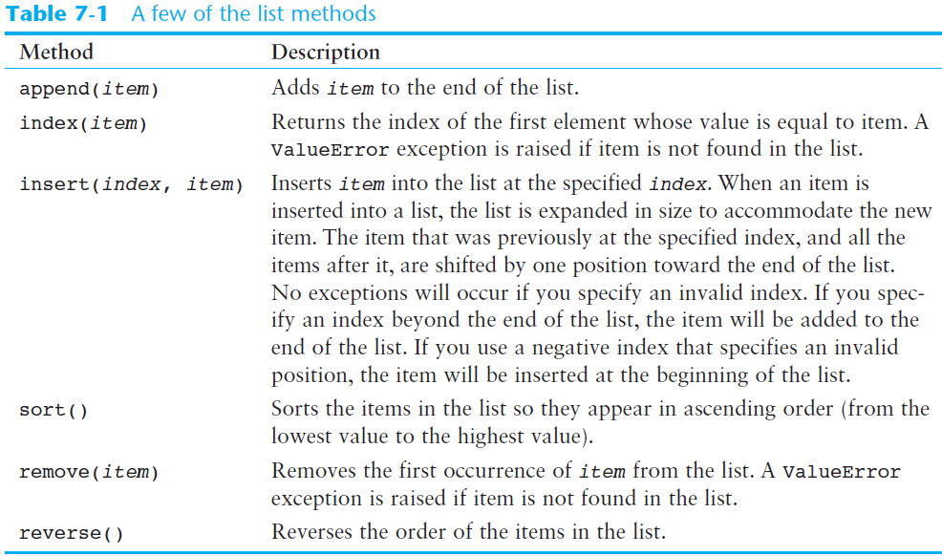

Slide 56
Index
food = ['Pizza', 'Burgers', 'Chips']
print('Here are the items in the food list:')
print(food)
item = input('Which item should I change? ')
item_index = food.index(item)
new_item = input('Enter the new value: ')
food[item_index] = new_item
print('Here is the revised list:')
print(food)

Slide 57
Index
Output:
Here are the items in the food list:
['Pizza', 'Burgers', 'Chips’]
Which item should I change? Chips
Enter the new value: Cola
Here is the revised list:
['Pizza', 'Burgers', 'Cola']

Slide 58
Insert
# Create a list with some names.
names = ['James', 'Kathryn', 'Bill']
# Display the list.
print('The list before the insert:')
print(names)
# Insert a new name at element 0.
names.insert(0, 'Joe')
# Display the list again.
print('The list after the insert:')
print(names)
Output:
The list before the insert:
['James', 'Kathryn', 'Bill']
The list after the insert:
['Joe', 'James', 'Kathryn', 'Bill']

Slide 59
Sort
my_list = [ 9, 5, 0, 1, 89, 100, 3]
print (my_list)
my_list.sort()
print('Sorted list:', my_list)
Output:
[ 9, 5, 0, 1, 89, 100, 3]
Sorted list: [ 0, 1, 3, 5, 9, 89, 100]

Slide 60
Lists are in Order
A list can hold many items and keeps those items in the order until we do something to change the order
A list can be sorted
(i.e., change its order)
The sort method (unlike in strings) means “sort yourself”
>>> friends = ['Sinem', 'Ali', 'Gizem' ]
>>> friends.sort()
>>> print(friends)
['Ali', 'Gizem', 'Sinem']
>>> print(friends[1])
Gizem
>>>

Slide 61
Remove
food = ['Pizza', 'Burgers', 'Chips’]
print('Here are the items in the food list:’)
print(food)
# Get the item to change.
item = input('Which item should I remove? ')
# Remove the item.
food.remove(item)
print('Here is the revised list:’)
print(food)

Slide 62
Remove
Output:
Here are the items in the food list:
['Pizza', 'Burgers', 'Chips']
Which item should I remove? Pizza
Here is the revised list:
['Burgers', 'Chips']

Slide 63
List Methods and Useful Built-in Functions (cont’d.)
del statement: removes an element from a specific index in a list
  General format: del list[i]
min and max functions: built-in functions that returns the item that has the lowest or highest value in a sequence
  The sequence is passed as an argument

Slide 64
Reverse & Deletion & Min & Max
my_list = [ 1, 2, 3, 4, 5]
print ("Original Order:", my_list)
my_list.reverse()
print("Reversed:", my_list)
del my_list[2]
print("After deletion:", my_list)
print("The lowest is" , min(my_list))
print("The highest is" , max(my_list))
Original Order: [ 1, 2, 3, 4, 5]
Reversed: [ 5, 4, 3, 2, 1]
After deletion:[ 5, 4, 2, 1]
The lowest is 1
The highest is 5

Slide 65
Built-in Functions and Lists
There are a number of functions built into Python that take lists as parameters
Remember the loops we built? These are much simpler.
>>> nums = [3, 41, 12, 9, 74, 15]
>>> print(len(nums))
6
>>> print(max(nums))
74
>>> print(min(nums))
3
>>> print(sum(nums))
154
>>> print(sum(nums)/len(nums))
25.6

Slide 66
Join Function
You choose a desired separator string, (often called the glue) and join the list with the glue between each of the elements.
wds = ["red", "blue", "green"]
glue = ';'
s = glue.join(wds)
print(s)
print(wds)
print("***".join(wds))
print("".join(wds))

Slide 67
Join Function
>>> wds = ["red", "blue", "green"]
>>> glue = ';'
>>> s = glue.join(wds)
>>> print(s)
red;blue;green
>>> print(wds)
['red', 'blue', 'green']
>>> print("***".join(wds))
red***blue***green
>>> print("".join(wds))
redbluegreen
>>> print(" ".join(wds))
red blue green
>>>

Slide 68
Copying Lists
To make a copy of a list you must copy each element of the list
  Two methods to do this:
    Creating a new empty list and using a for loop to add a copy of each element from the original list to the new list
    Creating a new empty list and concatenating the old list to the new empty list
list1 = [1, 2, 3, 4]
list2 = []
for item in list1:
list2.append(item)

Slide 69
Copying Lists
Creating a new empty list and concatenating the old list to the new empty list
list1 = [1, 2, 3, 4]
list2 = [] + list1
However if;
list1 = [1, 2, 3, 4]
list2 = list1
both variables list1 and list2 will reference the same list in memory.

Slide 70
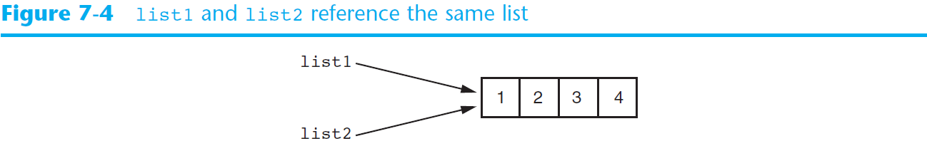
Copying Lists (cont’d.)

Slide 71
Processing Lists
List elements can be used in calculations
To calculate total of numeric values in a list use loop with accumulator variable
To average numeric values in a list:
  Calculate total of the values
  Divide total of the values by len(list)
List can be passed as an argument to a function

Slide 72
Totaling the Values in a List
# Create a list.
numbers = [2, 4, 6, 8, 10]
# Create a variable to use as an accumulator.
total = 0
# Calculate the total of the list elements.
for value in numbers:
total += value
# Display the total of the list elements.
print('The total of the elements is', total)
The total of the elements is 30

Slide 73
Averaging the Values in a List
# Create a list.
scores = [2.5, 7.3, 6.5, 4.0, 5.2]
# Create a variable to use as an accumulator.
total = 0.0
# Calculate the total of the list elements.
for value in scores:
total += value
# Calculate the average of the elements.
average = total / len(scores)
print('The average of the elements is', average)
The average of the elements is 5.3

Slide 74
total = 0
count = 0
while True :
inp = input('Enter a number: ')
if inp == 'done' : break
value = float(inp)
total = total + value
count = count + 1
average = total / count
print('Average:', average)
Enter a number: 3
Enter a number: 9
Enter a number: 5
Enter a number: done
Average: 5.66666666667
numlist = list()
while True :
inp = input('Enter a number: ')
if inp == 'done' : break
value = float(inp)
numlist.append(value)
average = sum(numlist) / len(numlist)
print('Average:', average)

Slide 75
Two-Dimensional Lists
Two-dimensional list: a list that contains other lists as its elements
  Also known as nested list
  Common to think of two-dimensional lists as having rows and columns
  Useful for working with multiple sets of data
To process data in a two-dimensional list need to use two indexes
Typically use nested loops to process

Slide 76
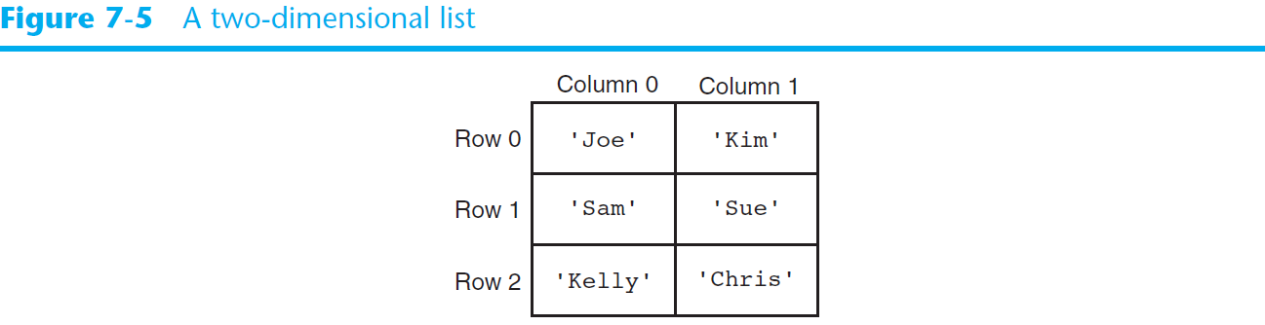
Two-Dimensional Lists (cont’d.)

Slide 77
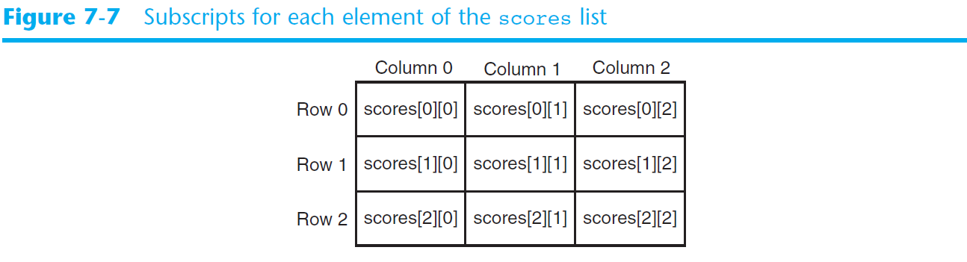
Two-Dimensional Lists (cont’d.)

Slide 78
Best Friends: Strings and Lists
>>> print(stuff)
['With', 'three', 'words']
>>> for w in stuff :
... print(w)
...
With
Three
Words
>>>
>>> abc = 'With three words'
>>> stuff = abc.split()
>>> print(stuff)
['With', 'three', 'words']
>>> print(len(stuff))
3
>>> print(stuff[0])
With
Split breaks a string into parts and produces a list of strings. We think of these as words. We can access a particular word or loop through all the words.

Slide 79
>>> line = 'A lot of spaces'
>>> etc = line.split()
>>> print(etc)
['A', 'lot', 'of', 'spaces']
>>>
>>> line = 'first;second;third'
>>> thing = line.split()
>>> print(thing)
['first;second;third']
>>> print(len(thing))
1
>>> thing = line.split(';')
>>> print(thing)
['first', 'second', 'third']
>>> print(len(thing))
3
>>>
When you do not specify a delimiter, multiple spaces are treated like one delimiter
You can specify what delimiter character to use in the splitting

Slide 80
From alicihan.keles@hotmail.com Thu Feb 27 09:14:16 2020
>>> line = 'From alicihan.keles@hotmail.com Thu Feb 27 09:14:16 2020'
>>> words = line.split()
>>> print(words)
['From', 'alicihan.keles@hotmail.com', 'Thu', 'Feb', '27', '09:14:16', '2020']
>>>

Slide 81
The Double Split Pattern
Sometimes we split a line one way, and then grab one of the pieces of the line and split that piece again
From alicihan.keles@hotmail.com Thu Feb 27 09:14:16 2020
words = line.split()
email = words[1]
print pieces[1]

Slide 82
The Double Split Pattern
From alicihan.keles@hotmail.com Thu Feb 27 09:14:16 2020
words = line.split()
email = words[1]
print pieces[1]
alicihan.keles@hotmail.com

Slide 83
The Double Split Pattern
From alicihan.keles@hotmail.com Thu Feb 27 09:14:16 2020
words = line.split()
email = words[1]
pieces = email.split('@')
alicihan.keles@hotmail.com
['alicihan.keles', 'hotmail.com']

Slide 84
The Double Split Pattern
From alicihan.keles@hotmail.com Thu Feb 27 09:14:16 2020
words = line.split()
email = words[1]
pieces = email.split('@’)
print(pieces[1])
alicihan.keles@hotmail.com
['alicihan.keles', 'hotmail.com']
'hotmail.com'

Slide 85
Tuples
Tuple: an immutable sequence
  Very similar to a list
  Once it is created it cannot be changed
  Format: tuple_name = (item1, item2)
  Tuples support operations as lists
    Subscript indexing for retrieving elements
    Methods such as index
    Built in functions such as len, min, max
    Slicing expressions
    The in, +, and * operators

Slide 86
Tuples
To create a tuple with a single element (but you’re probably not likely to do that too often), we have to include the final comma, because without the final comma, Python treats the (5) below as an integer in parentheses:
>>> t=(5,)
>>> print(type(t))
<class 'tuple'>
>>> t=(5)
>>> print(type(t))
<class 'int'>
>>>

Slide 87
Tuples
my_tuple = (1, 2, 3, 4, 5)
print my_tuple
(1, 2, 3, 4, 5)
names = (‘Deniz’, ‘Duru’, ‘Derin’)
for n in names:
print (n)
OR
names = (‘Deniz’, ‘Duru’, ‘Derin’)
for i in range(len(names)):
print (names[i])
Deniz
Duru
Derin

Slide 88
Example
>>> julia = ("Julia", "Roberts", 1967, "Duplicity", 2009, "Actress", "Atlanta, Georgia")
>>> print(julia[2])
1967
>>> print(julia[2:6])
(1967, 'Duplicity', 2009, 'Actress')
>>> print(len(julia))
7
>>> julia = julia[:3] + ("Eat Pray Love", 2010) + julia[5:]
>>> print(julia)
('Julia', 'Roberts', 1967, 'Eat Pray Love', 2010, 'Actress', 'Atlanta, Georgia')
>>>

Slide 89
Tuples Are Like Lists
Tuples are another kind of sequence that functions much like a list - they have elements which are indexed starting at 0
>>> x = ('Gizem', 'Sinem’, 'Ali')
>>> print(x[2])
Ali
>>> y = ( 1, 9, 2 )
>>> print(y)
(1, 9, 2)
>>> print(max(y))
9
>>> for iter in y:
... print(iter)
...
1
9
2
>>>

Slide 90
but... Tuples are “immutable”
Unlike a list, once you create a tuple, you cannot alter its contents - similar to a string
>>> x = [9, 8, 7]
>>> x[2] = 6
>>> print(x)
>>>[9, 8, 6]
>>>
>>> z = (5, 4, 3)
>>> z[2] = 0
Traceback:'tuple' object does
not support item
Assignment
>>>
>>> y = 'ABC'
>>> y[2] = 'D'
Traceback:'str' object does
not support item
Assignment
>>>

Slide 91
Tuples (cont’d.)
Tuples do not support the methods:
  append
  remove
  insert
  reverse
  sort

Slide 92
Things not to do With Tuples
>>> x = (3, 2, 1)
>>> x.sort()
Traceback:
AttributeError: 'tuple' object has no attribute 'sort'
>>> x.append(5)
Traceback:
AttributeError: 'tuple' object has no attribute 'append'
>>> x.reverse()
Traceback:
AttributeError: 'tuple' object has no attribute 'reverse'
>>>

Slide 93
Tuples (cont’d.)
Advantages for using tuples over lists:
  Processing tuples is faster than processing lists
  Tuples are safe
  Some operations in Python require use of tuples
list() function: converts tuple to list
tuple() function: converts list to tuple

Slide 94
Tuples are More Efficient
Since Python does not have to build tuple structures to be modifiable, they are simpler and more efficient in terms of memory use and performance than lists
So in our program when we are making “temporary variables” we prefer tuples over lists

Slide 95
Example
>>> my_tuple = (1, '2.3', 4, 'can', "istanbul", 3.14, """python""")
>>> print(my_tuple)
(1, '2.3', 4, 'can', 'istanbul', 3.14, 'python')
>>> list(my_tuple)
[1, '2.3', 4, 'can', 'istanbul', 3.14, 'python']
>>> a = list(my_tuple)
>>> print(a)
[1, '2.3', 4, 'can', 'istanbul', 3.14, 'python']
>>> print(a[1:5])
['2.3', 4, 'can', 'istanbul']
>>> tuple(a)
(1, '2.3', 4, 'can', 'istanbul', 3.14, 'python')
>>> b = tuple(a)
>>> print(b)
(1, '2.3', 4, 'can', 'istanbul', 3.14, 'python')
>>> print(b[2:6])
(4, 'can', 'istanbul', 3.14)
>>>

Slide 96
A Tale of Two Sequences
>>> l = list()
>>> dir(l)
['append', 'count', 'extend', 'index', 'insert', 'pop', 'remove', 'reverse', 'sort']
>>> t = tuple()
>>> dir(t)
['count', 'index']

Slide 97
Tuples and Assignment
We can also put a tuple on the left-hand side of an assignment statement
We can even omit the parentheses
>>> (x, y) = (4, 'cihan')
>>> print(y)
cihan
>>> (a, b) = (99, 98)
>>> print(a)
99

Slide 98
Tuples are Comparable
The comparison operators work with tuples and other sequences. If the first item is equal, Python goes on to the next element, and so on, until it finds elements that differ.
>>> (0, 1, 2) < (5, 1, 2)
True
>>> (0, 1, 2000000) < (0, 3, 4)
True
>>> ('Cihan', 'Sinan') < ('Cihan', 'Sinem')
True
>>> ('Cihan', 'Sinan') > ('Ali', 'Sinem')
True

Slide 99
Sorting Lists of Tuples
We can take advantage of the ability to sort a list of tuples to get a sorted version of a dictionary
First we sort the dictionary by the key using the items() method and sorted() function
>>> d = {'a':10, 'b':1, 'c':22}
>>> d.items()
dict_items([('a', 10), ('c', 22), ('b', 1)])
>>> sorted(d.items())
[('a', 10), ('b', 1), ('c', 22)]

Slide 100
Plotting Data with matplotlib
The matplotlib package is a library for creating two-dimensional charts and graphs.
It is not part of the standard Python library, so you will have to install it separately, after you have installed Python on your system.

Slide 101
Plotting Data with matplotlib
To install matplotlib on a Windows system, open a Command Prompt window and enter this command:
To install matplotlib on a Mac or Linux system, open a Terminal window and enter this command:
See Appendix F in your textbook for more information about packages and the pip utility.
pip install matplotlib
sudo pip3 install matplotlib

Slide 102
Plotting Data with matplotlib
To verify the package was installed, start IDLE and enter this command:
If you don't see any error messages, you can assume the package was properly installed.
>>> import matplotlib

Slide 103
Plotting Data with matplotlib
The matplotlib package contains a module named pyplot that you will need to import.
Use the following import statement to import the module and create an alias named plt:
import matplotlib.pyplot as plt
For more information about the import statement, see Appendix E in your textbook.

Slide 104
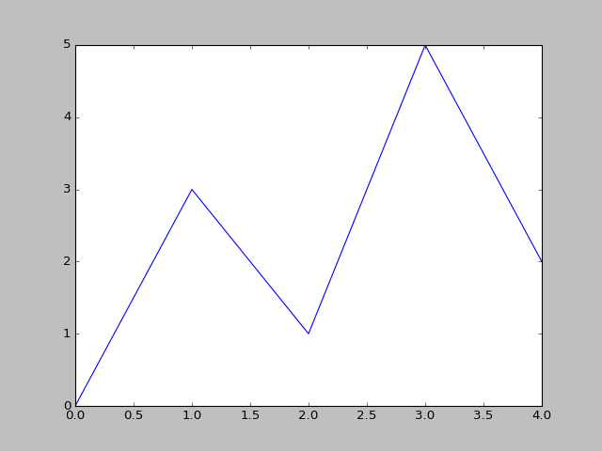
Plotting a Line Graph with the plot Function
Use the plot function to create a line graph that connects a series of points with straight lines.
The line graph has a horizontal X axis, and a vertical Y axis.
Each point in the graph is located at a (X,Y) coordinate.

Slide 105
Plotting a Line Graph with the plot Function
Program 7-19 (line_graph1.py)
1 # This program displays a simple line graph.
2 import matplotlib.pyplot as plt
3
4 def main():
5 # Create lists with the X and Y coordinates of each data point.
6 x_coords = [0, 1, 2, 3, 4]
7 y_coords = [0, 3, 1, 5, 2]
8
9 # Build the line graph.
10 plt.plot(x_coords, y_coords)
11
12 # Display the line graph.
13 plt.show()
14
15 # Call the main function.
16 main()

Slide 106
Plotting a Line Graph with the plot Function
You can change the lower and upper limits of the X and Y axes by calling the xlim and ylim functions. Example:
This code does the following:
  Causes the X axis to begin at 1 and end at 100
  Causes the Y axis to begin at 10 and end at 50
plt.xlim(xmin=1, xmax=100)
plt.ylim(ymin=10, ymax=50)

Slide 107
Plotting a Line Graph with the plot Function
You can customize each tick mark's label with the xticks and yticks functions.
These functions each take two lists as arguments.
  The first argument is a list of tick mark locations
  The second argument is a list of labels to display at the specified locations.
plt.xticks([0, 1, 2, 3, 4],
['2016', '2017', '2018', '2019', '2020'])
plt.yticks([0, 1, 2, 3, 4, 5],
['$0m', '$1m', '$2m', '$3m', '$4m', '$5m'])

Slide 108
Program 7-24
1 # This program displays a simple line graph.
2 import matplotlib.pyplot as plt
3
4 def main():
5 # Create lists with the X,Y coordinates of each data point.
6 x_coords = [0, 1, 2, 3, 4]
7 y_coords = [0, 3, 1, 5, 2]
8
9 # Build the line graph.
10 plt.plot(x_coords, y_coords, marker='o')
11
12 # Add a title.
13 plt.title('Sales by Year')
14
15 # Add labels to the axes.
16 plt.xlabel('Year')
17 plt.ylabel('Sales')
18
Continued…

Slide 109
Program 7-24 (continued)
19 # Customize the tick marks.
20 plt.xticks([0, 1, 2, 3, 4],
21 ['2016', '2017', '2018', '2019', '2020'])
22 plt.yticks([0, 1, 2, 3, 4, 5],
23 ['$0m', '$1m', '$2m', '$3m', '$4m', '$5m'])
24
25 # Add a grid.
26 plt.grid(True)
27
28 # Display the line graph.
29 plt.show()
30
31 # Call the main function.
32 main()

Slide 110
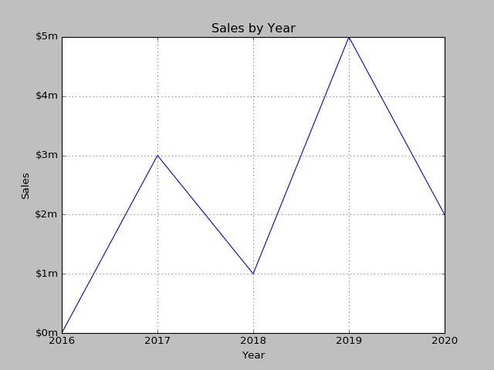
Output of Program 7-24
Displayed by the yticks() function.
Displayed by the title() function.
Displayed by the ylabel() function.
Displayed by the xticks() function.
Displayed by the xlabel() function.

Slide 111
Plotting a Bar Chart
Use the bar function in the matplotlib.pyplot module to create a bar chart.
The function needs two lists: one with the X coordinates of each bar's left edge, and another with the heights of each bar, along the Y axis.

Slide 112
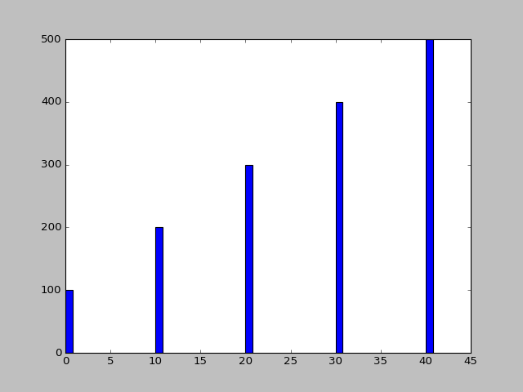
Plotting a Bar Chart
left_edges = [0, 10, 20, 30, 40]
heights = [100, 200, 300, 400, 500]
plt.bar(left_edges, heights)
plt.show()

Slide 113
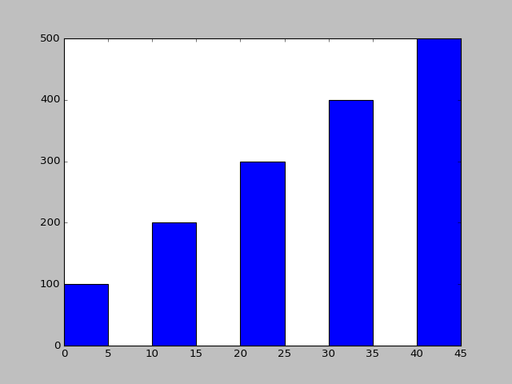
Plotting a Bar Chart
The default width of each bar in a bar graph is 0.8 along the X axis.
You can change the bar width by passing a third argument to the bar function.
left_edges = [0, 10, 20, 30, 40]
heights = [100, 200, 300, 400, 500]
bar_width = 5
plt.bar(left_edges, heights, bar_width)
plt.show()

Slide 114
Plotting a Bar Chart
The bar function has a color parameter that you can use to change the colors of the bars.
The argument that you pass into this parameter is a tuple containing a series of color codes.
Color Code | Corresponding Color
'b' | Blue
'g' | Green
'r' | Red
'c' | Cyan
'm' | Magenta
'y' | Yellow
'k' | Black
'w' | White

Slide 115
Plotting a Bar Chart
Example of how to pass a tuple of color codes as a keyword argument:
The colors of the bars in the resulting bar chart will be as follows:
  The first bar will be red.
  The second bar will be green.
  The third bar will be blue.
  The fourth bar will be white.
  The fifth bar will be black.
plt.bar(left_edges, heights, color=('r', 'g', 'b', 'w', 'k'))

Slide 116
Plotting a Bar Chart
Use the xlabel and ylabel functions to add labels to the X and Y axes.
Use the xticks function to display custom tick mark labels along the X axis
Use the yticks function to display custom tick mark labels along the Y axis.

Slide 117
Plotting a Pie Chart
You use the pie function in the matplotlib.pyplot module to create a pie chart.
When you call the pie function, you pass a list of values as an argument.
  The sum of the values will be used as the value of the whole.
  Each element in the list will become a slice in the pie chart.
  The size of a slice represents that element's value as a percentage of the whole.

Slide 118
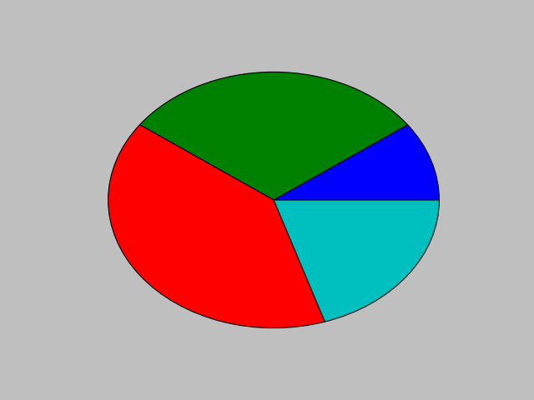
Plotting a Pie Chart
Example
values = [20, 60, 80, 40]
plt.pie(values)
plt.show()

Slide 119
Plotting a Pie Chart
The pie function has a labels parameter that you can use to display labels for the slices in the pie chart.
The argument that you pass into this parameter is a list containing the desired labels, as strings.

Slide 120
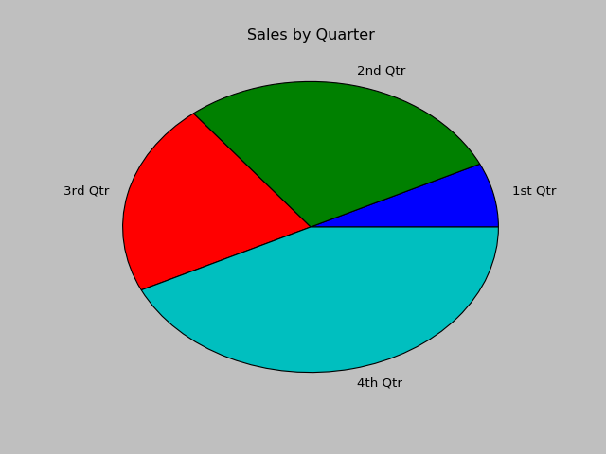
Plotting a Pie Chart
Example
sales = [100, 400, 300, 600]
slice_labels = ['1st Qtr', '2nd Qtr', '3rd Qtr', '4th Qtr']
plt.pie(sales, labels=slice_labels)
plt.title('Sales by Quarter')
plt.show()

Slide 121
Plotting a Pie Chart
The pie function automatically changes the color of the slices, in the following order:
  blue, green, red, cyan, magenta, yellow, black, and white.
You can specify a different set of colors, however, by passing a tuple of color codes as an argument to the pie function's colors parameter:
When this statement executes, the colors of the slices in the resulting pie chart will be red, green, blue, white, and black.
plt.pie(values, colors=('r', 'g', 'b', 'w', 'k'))

Slide 122
Summary
This chapter covered:
  Lists, including:
    Repetition and concatenation operators
    Indexing
    Techniques for processing lists
    Slicing and copying lists
    List methods and built-in functions for lists
    Two-dimensional lists
  Tuples, including:
    Immutability
    Difference from and advantages over lists
  Plotting charts and graphs with the matplotlib Package

Slide 123


Acknowledgements / Contributions
These slides are Copyright 2010- Charles R. Severance (www.dr-chuck.com) of the University of Michigan School of Information and open.umich.edu and made available under a Creative Commons Attribution 4.0 License. Please maintain this last slide in all copies of the document to comply with the attribution requirements of the license. If you make a change, feel free to add your name and organization to the list of contributors on this page as you republish the materials.
Initial Development: Charles Severance, University of Michigan School of Information
… Insert new Contributors and Translators here
...

